Slide 1
Empowering Skills for Professional Success

Slide 2
About Me - Adnan Majeed
MCS Qualified Professional with over 12 years of experience
- Expertise in teaching, research, and administration
- Proficient in Python, Matlab, R, Java, and SQL
- Specialist in Machine Learning, Deep Learning, and Data Analytics
- Accomplished in web development and backend API development
- Published researcher with articles in international journals
- Certified Microsoft System Engineer with additional certifications in CISCO and Linux
- Passionate about empowering students and professionals through education and training
Teaching at Lahore Leads University

Slide 3


Boosting Your Career: Essential Skills & Strategies
In today's competitive job market, acquiring the right skills and strategies is crucial for career success. This presentation will equip you with the essential tools to navigate your professional journey, from website creation to interviewing and project acquisition. Join us as we explore practical techniques to enhance your online presence and ultimately achieve your career goals.
by Adnan Majeed

Slide 4
Creating a Professional Website with WordPress & Elementor
WordPress: The Foundation
Elementor: Building Blocks
WordPress is a user-friendly content management system (CMS) that allows you to create and manage your website without coding knowledge. It offers a vast library of themes and plugins, providing flexibility and customization.
Elementor is a popular drag-and-drop website builder that seamlessly integrates with WordPress. It empowers you to create stunning visuals, customize layouts, and build engaging website experiences without coding.

Slide 5
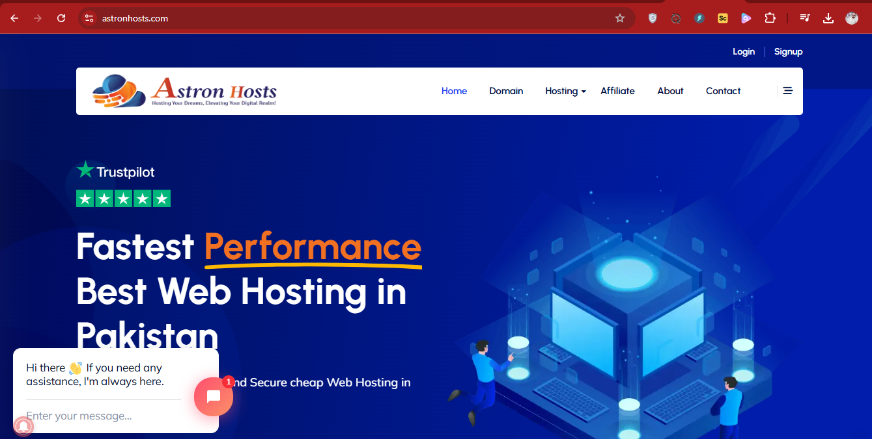
Choosing Your Domain & Hosting Platform
Domain Name
Hosting Platform
Your domain name is your website's address on the internet. Choose a name that is relevant, memorable, and easy to spell. Consider using your name, business name, or a relevant keyword.
Your hosting platform provides storage space and resources for your website. Research reputable hosting providers like Bluehost, GoDaddy, or HostGator. Compare features, pricing, and customer support to find the best fit.

Slide 6




Crafting a Professional CV
Highlight Key Skills
Tailor to Each Role
Showcase Your Work
Emphasize skills relevant to the target job description. Quantify your achievements whenever possible to showcase your impact.
Customize your CV for each job application by highlighting experiences and skills relevant to the specific position.
Include a portfolio section if applicable. This allows you to demonstrate your skills and projects in a tangible way.

Slide 7

Navigating the Interview Process
1
Prepare for Common Questions: Research typical interview questions and rehearse your answers. Focus on your skills, experiences, and career goals.
2
Practice STAR Method: Use the STAR method to structure your responses, providing Situation, Task, Action, and Result for each experience.
3
Ask Thoughtful Questions: Prepare insightful questions to demonstrate your interest and engagement. Ask about the company culture, team dynamics, and future opportunities.

Slide 8




Mastering Interview Questions & Answers
Behavioral Questions
Describe a time you failed and what you learned. Tell me about a time you disagreed with a colleague. These questions assess your problem-solving abilities, teamwork, and resilience.
Situational Questions
How would you handle a difficult client? What would you do if you faced a deadline conflict? These questions evaluate your decision-making, problem-solving, and adaptability.
Technical Questions
These focus on your specific skills and knowledge related to the job. Be prepared to demonstrate your expertise in your field.

Slide 9



Interview Dress Code: Projecting Confidence
Professional Attire
1
For most interviews, a suit or business casual attire is appropriate. Choose clean, well-fitting clothes that make you feel comfortable and confident.
Clean & Polished
2
Ensure your shoes are polished, accessories are minimal, and hair is neatly styled. Pay attention to details to project a professional image.
Confidence & Comfort
3
Choose clothes that make you feel confident and comfortable. Avoid wearing anything that might distract you or the interviewer.

Slide 10
Securing Projects: Expanding Your Network
Networking
1
Attend industry events, join online communities, and connect with professionals on LinkedIn. Build relationships and expand your professional network.
Freelancing Platforms
2
Explore platforms like Upwork, Fiverr, and Freelancer. Create a compelling profile and submit proposals for projects that align with your skills.
Word-of-Mouth
3
Leverage your existing network and inform contacts about your services. Encourage referrals and recommendations to secure new projects.

Slide 11
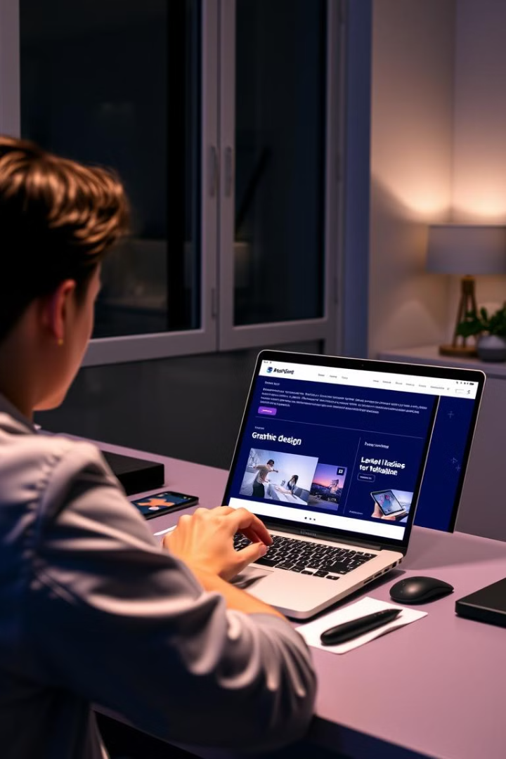
Boosting Your Online Presence
1
Professional Profile
Create a professional online presence by building a strong LinkedIn profile and showcasing your skills and experience.
2
Content Creation
Contribute to industry blogs, share your expertise on social media, and participate in online discussions to build credibility.
3
Portfolio Website
Create a website that showcases your work, skills, and accomplishments. It serves as a platform to attract potential clients and employers.

Slide 12
Thank you

